Slide 1
Pipelining: Basic and Intermediate Concepts
Appendix C

Slide 2
Outline
Introduction
The major hurdle of pipelining-pipeline hazards
How is pipelining implemented?
What Makes Pipelining Hard to Implement?
Extending the RISC-V Pipeline to Handle Multicycle Operations
Putting It All together: The MIPS R4000 Pipeline
Crosscutting Issues

Slide 3
Introduction
What is Pipelining
Pipelining is an implementation technique whereby multiple
instructions are overlapped in execution; it takes
advantage of parallelism that exists among the actions
needed to execute an instruction.

Slide 4
Pizza example
Let’s look at two ways to make pizzas.
The first away is based on a sequential procedure.
  Toss the dough (2 min)
  Add the sauce (2 min)
  Add the cheese (2 min)
  Add the toppings (2 min)
  Bake in oven (2 min – to help this example!)
10 mins for one pizza
Throughput= 1/10 pizza/min

Slide 5
Since each step in pizza making is distinct, we can start
a second pizza once we have tossed the dough for the first.
Therefore, a pizza pipelining schedule can be arranged
as shown below.
dough | sauce | cheese | topping | oven
 | dough | sauce | cheese | topping | oven
 |  | dough | sauce | cheese | topping | oven
2 min
2 mins for one pizza
Throughput = 0.5 pizza/min

Slide 6
As shown in the pizza example, a pipeline can be separated
into many steps. Each of these steps is called a pipe stage
or pipe segment.
There are 5 pipe stages in the pizza pipeline.

Slide 7
The basics of a RISC instruction set
The pipeline can be effectively used to enhance the
throughput of the RISC (reduced instruction set
computer).
RISC architectures are characterized by the following
properties:
All operations on data apply to data in registers and
typically change the entire register.
(b) The only operations that affect memory are load and
store operations.
(c) The instruction formats are few in number with all
instructions typically being one size.

Slide 8
Most RISC architectures have three classes of
instructions:
ALU instructions
Load and store instructions
Branches and jumps

Slide 9
A simple implementation of a RISC instruction set
Here we consider the implementation of a RISC
instruction set without pipelining. In this implementation,
every instruction takes at most 5 clock cycles. The 5
cycles are shown below.
Instruction fetch cycle (IF),
Instruction decode/register fetch cycle (ID),
Execution/effective address cycle (EX),
Memory access/branch completion cycle (MEM),
Write-back cycle (WB).

Slide 10
IF
ID
EX
MEM
WB
m
u
x
NPC
+
=?
Cond
4
rs1
PC
Registers
rs2
m
u
x
Instruction
memory
A
IR
Data
memory
rd
ALU
output
m
u
x
B
ALU
LMD
m
u
x
Sign-
extend
Imm

Slide 11
All the instructions have identical IF
IF
Send out the PC and fetch the instruction from memory
into the IR.
IR ← Mem[PC];
Increment the PC by 4 to address the next sequential
instruction.
NPC ← PC+4;

Slide 12
IF
IF
ID
EX
MEM
WB
m
u
x
NPC
+
=?
Cond
4
rs1
PC
Registers
rs2
m
u
x
Instruction
memory
A
IR
Data
memory
rd
ALU
output
m
u
x
B
ALU
LMD
m
u
x
Sign-
extend
Imm

Slide 13
All the instructions have identical ID
ID
Decode the instruction.
Access the register file to read the registers. The output
of the general purpose registers are read into two
temporary registers (A and B) for use in later clock cycles.
A ← Regs[rs1];
B ← Regs[rs2];
3. The immediate field of the IR is also sign extended and
store into temporary register Imm.
Imm ← sign-extended immediate field of IR;

Slide 14
IF
ID
EX
MEM
WB
m
u
x
NPC
+
=?
Cond
4
rs1
PC
Registers
rs2
m
u
x
Instruction
memory
A
IR
Data
memory
rd
ALU
output
m
u
x
B
ALU
LMD
m
u
x
Sign-
extend
Imm

Slide 15
The EX, MEM and WB stages may be different for different
instructions.
Load instruction
EX
ALUOutput ← A + Imm;
MEM
LMD ← Mem[ALUOutput];
PC ← NPC;
WB
Regs[rd] ← LMD;

Slide 16
Load instruction(EX, MEM and WB)
IF
ID
EX
MEM
WB
m
u
x
NPC
+
=?
Cond
4
rs1
PC
Registers
rs2
m
u
x
MEM[Reg[x2]+10]
Instruction
memory
A
Reg[x2]+10
IR
Reg[x2]
Data
memory
rd
ALU
output
3
m
u
x
B
ALU
LMD
m
u
x
ld x3, 10(x2)
x3⬅MEM[Reg[x2]+10]
Sign-
extend
Imm
10

Slide 17
Store instruction
EX
ALUOutput ← A + Imm;
MEM
Mem[ALUOutput] ←B;
PC ← NPC;
WB
No Operation

Slide 18
Store instruction(EX, MEM and WB)
IF
ID
EX
MEM
WB
m
u
x
NPC
+
=?
Cond
4
rs1
PC
Registers
Reg[x2]
rs2
m
u
x
Instruction
memory
A
Reg[x2+10]
IR
Data
memory
rd
Reg[x3]
ALU
output
m
u
x
B
ALU
LMD
m
u
x
sd x3, 10(x2)
Sign-
extend
Imm
10
MEM[Reg[x2]+10]⬅Reg[x3]

Slide 19
Register-Register ALU instruction
EX
ALUOutput ← A func B;
MEM
PC ← NPC;
WB
Regs[rd] ← ALUOutput;

Slide 20
Register-register ALU (EX, MEM and WB)
IF
ID
EX
MEM
WB
m
u
x
NPC
+
=?
Cond
4
rs1
PC
Registers
Reg[x2]
rs2
m
u
x
Reg[x2]+Reg[x1]
Instruction
memory
A
IR
Data
memory
3
rd
Reg[x1]
ALU
output
m
u
x
B
ALU
LMD
m
u
x
add x3, x2, x1
Reg[x3]⬅Reg[x2]+Reg[x1]
Sign-
extend
Imm

Slide 21
Register-Immediate ALU instruction
EX
ALUOutput ← A op Imm;
MEM
PC ← NPC;
WB
Regs[rd] ← ALUOutput;

Slide 22
Register-Immediate ALU (EX, MEM and WB)
IF
ID
EX
MEM
WB
m
u
x
NPC
+
=?
Cond
4
rs1
PC
Registers
Reg[x2]
rs2
m
u
x
Instruction
memory
A
Reg[x2]+10
IR
Data
memory
3
rd
ALU
output
m
u
x
B
ALU
LMD
m
u
x
addi x3, x2, #10
Reg[x3]⬅Reg[x2]+10
Sign-
extend
Imm
10

Slide 23
Branch instruction
EX
ALUOutput ← NPC + (Imm << 2);
Cond ← (A==B)
MEM
for BEQ
If (Cond) PC ← ALUOutput
else PC ← NPC;
WB
No operation

Slide 24
Branch (EX, MEM and WB)
IF
ID
EX
MEM
WB
m
u
x
NPC
NPC
+
=?
Cond
4
rs1
Yes
PC
Registers
Reg[x3]
rs2
m
u
x
Instruction
memory
A
NPC+400
IR
Data
memory
rd
Reg[x4]
ALU
output
m
u
x
B
ALU
LMD
PC⬅NPC+400
m
u
x
BEQ x3,x4, 100
(x3==x4)
Sign-
extend
Imm
100

Slide 25
The classic five-stage pipeline for a
RISC Processor
A simple five-stage implementation of pipeline.
Instruction Number | Clock number
 | 1 | 2 | 3 | 4 | 5 | 6 | 7 | 8 | 9
Instruction i | IF | ID | EX | MEM | WB
Instruction i+1 |  | IF | ID | EX | MEM | WB
Instruction i+2 |  |  | IF | ID | EX | MEM | WB
Instruction i+3 |  |  |  | IF | ID | EX | MEM | WB
Instruction i+4 |  |  |  |  | IF | ID | EX | MEM | WB

Slide 26
To design a pipeline system, we first have to make sure
that two different operations will not be performed with
the same data path resource on the same clock cycle.
For example, a single ALU can not be asked to compute
an effective address and perform a subtract operation
at the same time.

Slide 27
CC1
CC2
CC3
CC4
CC5
CC6
CC7
CC8
IM
Reg
ALU
DM
Reg
IM
Reg
ALU
DM
Reg
IM
Reg
ALU
DM
Reg
IM
Reg
ALU
DM
Reg
Data path resources
used by the executions of multiple instructions.

Slide 28
In the pipeline, overlapping the execution of multiple
instructions introduces relatively few conflicts.
There are three observations on which this fact rests.
We use separate instruction and data memories,
which we would typically implement with separate
instruction and data caches. The use of separate
caches eliminates a conflict for a single memory
that would arise between instruction fetch and data
memory access.

Slide 29
(2) The register file is used in the two stages: one for
reading in ID and one for writing in WB. To handle
reads and a write to the same register, we perform
the register write in the first half of the clock
and the read in the second half.
(3) To start a new instruction every clock, we must
increment and store PC every clock, this must be
done during the IF stage in preparation for the next
instruction. Furthermore, we must also have an adder
to compute the potential branch target. One further
problem is that a branch does not change the PC
until MEM stage. We will solve this problem shortly.

Slide 30
Although it is critical to ensure that instructions in the
pipeline do not attempt to use hardware resources at
the same time, we must also ensure that instructions
in different stages of the pipeline do not interfere with
one another. This separation is done by using
pipeline registers between successive stages of
the pipeline.

Slide 31
The pipeline registers also play the key role of
carrying intermediate results.
For example, the result of an ALU instruction is computed
during EX, but not actually stored until WB; it arrives
there by passing through two pipeline registers.

Slide 32
CC1
CC2
CC3
CC4
CC5
CC6
IM
Reg
ALU
DM
Reg
IM
Reg
ALU
DM
Reg
Data path with
pipeline registers
IM
Reg
ALU
DM

Slide 33
The major hurdle of pipelining-pipeline hazards
There are three classes of pipeline hazards:
Structural hazards arise from resource conflicts when
hardware cannot support all possible combinations of
instructions simultaneously in overlapped execution.
Data hazards occur when the pipeline changes the order
of read/write accesses to operands so that the order
differs from the order seen by sequentially executing
instructions on an unpipelined processor.
Control hazards arise from the pipelining of branches and
other instructions that change PC.

Slide 34
Data Hazards
Consider the pipelined execution of these instructions:
add x1, x2, x3
sub x4, x1, x5
and x6, x1, x7
The add instruction writes the value of x1 in the WB pipe
stage, but the sub reads the value during its ID stage.
This is a typical example of data hazard. In fact, the and
instruction is also affected by the data hazard.

Slide 35
CC1
CC2
CC3
CC4
CC5
CC6
add x1, x2, x3
IM
Reg
ALU
DM
Reg
sub x4, x1, x5
IM
Reg
ALU
DM
Reg
and x6, x1, x7
IM
Reg
ALU
DM

Slide 36
The data hazard may be solved with a simple hardware
technique called forwarding.
That is, we forward the result of add to sub and
and before it is written into x1.

Slide 37
CC1
CC2
CC3
CC4
CC5
CC6
IM
Reg
ALU
DM
Reg
add x1, x2, x3
IM
sub x4, x1, x5
IM
Reg
ALU
DM
Reg
and x6, x1, x7
IM
Reg
ALU
DM

Slide 38
Not all potential data hazards can be handled by
forwarding. Consider the following sequence of
instructions:
ld x1,0(x2)
sub x4,x1,x5
and x6,x1,x7

Slide 39
CC1
CC2
CC3
CC4
CC5
CC6
ld x1, 0(x2)
IM
Reg
ALU
DM
Reg
sub x4, x1, x5
IM
Reg
ALU
DM
Reg
and x6, x1, x7
IM
Reg
ALU
DM

Slide 40
The ld instruction does not have the data until
the end of CC4, while the sub instruction needs
to have the data by the beginning of CC4. Hence,
the simple forwarding technique can not
eliminate the data hazard problem. Therefore, a stall
is necessary.
In this case, we need a hardware to detect the hazard
and stall the pipeline until the hazard is cleared.
The hardware is called the pipeline interlock.

Slide 41
Instruction | Clock number
 | 1 | 2 | 3 | 4 | 5 | 6 | 7 | 8 | 9
ld x1,0(x2) | IF | ID | EX | MEM | WB
sub x4,x1,x5 |  | IF | ID | Stall | EX | MEM | WB
and x6,x1,x7 |  |  | IF | Stall | ID | EX | MEM | WB
or x8,x1,x9 |  |  |  | Stall | IF | ID | EX | MEM | WB

Slide 42
Data hazards may be classified as one of three types,
depending on the order of read and write accesses
in the instructions. By convention, the hazards are
named by the ordering in the program that must be
preserved by the pipeline.

Slide 43
Consider two instructions i and j, with i occurring
before j in program order. The possible data hazards
are:
RAW (read after write)- j tries to read a source before
i writes it, so j incorrectly gets the old value. In the
simple 5-stage pipeline considered here, RAW is
the only possible pipeline hazard.
WAW(write after write)- j tries to write an operand before
it is written by i. WAW may exist between a short integer
pipeline and a long floating-point pipeline.
WAR(write after read)- j tries to write a destination before
it is read by i, so i incorrectly get a new value. WAR may
exist when instructions are reordered.

Slide 44
Control Hazards
Control hazards can cause a greater performance loss
for pipeline than do data hazards. When a branch
is executed, it may or may not change the PC to
something other than its current value plus 4.
If a branch changes the PC to its target address, it is a
taken branch; if it falls through, it is untaken.

Slide 45
Flush/stall pipeline
The simplest way to handle the branch is to stall
the pipeline until the branch is complete. However,
this approach may be too slow.
A common improvement over branch stalling is to
assume that branch will not be taken and thus continue
execution down the sequential instruction stream.
this scheme is called predicted-not-taken scheme. If
the branch is taken, the instructions that are being
fetched and decoded must be discarded. Execution
continues at the branch target.
Predicted-not-taken/Predicted untaken

Slide 46
A pipeline sequence of the predicted-not-taken scheme
when the branch is taken.
Instruction | Clock number
 | 1 | 2 | 3 | 4 | 5 | 6 | 7 | 8 | 9
Instruction i (Branch instruction) | IF | ID | EX | MEM | WB
Instruction i+1 |  | IF | ID | EX | Idle | Idle
Instruction i+2 |  |  | IF | ID | Idle | idle | Idle
Instruction i+3 |  |  |  | IF | Idle | Idle | Idle | Idle
Branch target |  |  |  |  | IF | ID | EX | MEM | WB

Slide 47
One way to improve branch performance is to
reduce the cost of the taken branch. If we
move the branch execution earlier in the
pipeline, then fewer instructions need to be flushed.
Many implementations move the branch
execution to the ID stage. We will describe this
implementation later.

Slide 48
Predicted-taken
An alternative scheme is to treat every branch as taken.
However, because in our 5-stage pipeline we do not
know the target address any earlier than we know the
branch outcome, there is no advantage in this approach
for this outcome.

Slide 49


Performance of Branch Schemes
Pipeline depth
Pipeline Speedup =
1+Pipeline stall cycles from branches
Pipeline stall cycles from branches
= Branch frequency × Branch penalty
Pipeline depth
Pipeline Speedup =
1+ Branch frequency × Branch penalty

Slide 50
How is Pipelining Implemented ?
A basic pipeline for RISC-V
The pipeline registers carry both data and control from
one pipeline stage to the next. Any value needed on a
latter stage must be placed in such a register and
copied from one pipeline register to the next.

Slide 51
IF/ID
ID/EX
EX/MEM
MEM/WB
m
u
x
+
=?
4
PC
Registers
m
u
x
Data
memory
Instruction
memory
m
u
x
ALU
m
u
x
Sign-
extend

Slide 52
Events on every pipe stage of the MIPS pipeline are
shown below.
IF stage:
IF/ID.IR ←Mem[PC];
IF/ID.NPC, PC ←(if ( (EX/MEM.opcode == branch) &
EX/MEM.cond){EX/MEM.ALUOutput}
else {PC+4});
ID stage:
ID/EX.A ←Regs[IF/ID.IR[rs1]];
ID/EX.B ←Regs[IF/ID.IR[rs2]];
ID/EX.NPC ← IF/ID.NPC;
ID/EX.IR ← IF/ID.IR;
ID/EX.Imm ← sign-extend(IF/ID.IR[immediate field]);

Slide 53
ALU instruction
EX stage:
EX/MEM.IR ←ID/EX.IR;
EX/MEM.ALUOutput ←ID/EX.A func ID/EX.B;
or
EX/MEM.ALUOutput ←ID/EX.A op ID/EX.Imm;
MEM stage:
MEM/WB.IR ← EX/MEM.IR;
MEM/WB.ALUOutput ← EX/MEM.ALUOutput;
WB stage:
Regs[MEM/WB.IR[rd]] ←MEM/WB.ALUOutput;

Slide 54
Load or store instruction
EX stage:
EX/MEM.IR ← ID/EX.IR;
EX/MEM.ALUOutput ← ID/EX.A + ID/EX.Imm;
EX/MEM.B ← ID/EX.B;
MEM stage:
For load:
MEM/WB.IR ←EX/MEM.IR;
MEM/WB.LMD ←Mem[EX/MEM.ALUOutput];
For store:
Mem[EX/MEM.ALUOutput] ← EX/MEM.B;
WB stage:
For load only:
Regs[MEM/WB.IR[rd]] ← MEM/WB.LMD;

Slide 55
Branch instruction
EX stage:
EX/MEM.ALUOutput ← ID/EX.NPC + (ID/EX.Imm <<2);
EX/MEM.cond ← (ID/EX.A == ID/EX.B);

Slide 56
Dealing with data hazards
Here we briefly describe the implementation of
interlock and forwarding logics for the data hazards.
To implement the interlock, we only consider the ld
instruction for the demonstration purpose.

Slide 57
A table showing the a variety of situations that we must handle for load.
Situation | Example Code Sequence
No dependence | ld x1, 45(x2) add x5, x6, x7 sub x8, x6, x7 or x9, x6, x7
Dependence requiring stall | ld x1, 45(x2) add x5, x1, x7 sub x8, x6, x7 or x9, x6, x7
Dependence overcome by forwarding | ld x1, 45(x2) add x5, x6, x7 sub x8, x1, x7 or x9, x6, x7
Dependence with accesses in order | ld x1, 45(x2) add x5, x6, x7 sub x8, x6, x7 or x9, x1, x7

Slide 58
If there is a RAW hazard with the source instruction being a load, the load instruction will be in the EX stage when an instruction that needs the load data is in the ID stage.
IF | ID | EX | MEM | WB
 | Instruction need load data | load

Slide 59
A small table describing all possible hazard situations for load.
It can be directly translated into an interlock implementation.
Opcode field of ID/EX (ID/EX.IR_{0..6}) | Opcode field of IF/ID (IF/ID.IR_{0..6}) | Matching operand fields
Load | Register-register ALU, Load, Store, ALU Immediate, or Branch | ID/EX.IR[rd]== IF/ID.IR[rs1]
Load | Register-Register ALU, Store or branch | ID/EX.IR[rd]== IF/ID.IR[rs2]

Slide 60
Implementing the forwarding logic is similar, although
there are more cases to consider. All forwarding
happens from the ALU output or data memory output to
the ALU input, data memory input, or the equality detection
unit.

Slide 61
A table showing all the possible forwarding operations for
the instruction currently in the EX.
Source Instruction |  | Destination Instruction |  | Condition
Pipeline Register | Opcode | Pipeline Register | Opcode
EX/MEM | Register-register ALU, ALU Immediate | ID/EX | Register-register ALU, ALU Immediate, Load, Store, Branch | EX/MEM.IR[rd]== ID/EX.IR[rs1]
EX/MEM | Register-register ALU, ALU Immediate | ID/EX | Register-register ALU Store, Branch | EX/MEM.IR[rd]== ID/EX.IR[rs2]
MEM/WB | Register-register ALU, ALU Immediate, Load | ID/EX | Register-register ALU, ALU Immediate, Load, Store, Branch | MEM/WB.IR[rd]== ID/EX.IR[rs1]
MEM/WB | Register-register ALU, ALU Immediate, Load | ID/EX | Register-register ALU Store, Branch | MEM/WB.IR[rd]== ID/EX.IR[rs2]

Slide 62
In addition to the comparators and combinational
logic that we need to determine when a
forwarding path needs to be enabled, we also need
to enlarge the multiplexers at the ALU inputs and
add the connections from the pipeline registers
that are used to forward the results.

Slide 63
ID/EX
EX/MEM
MEM/WB
=?
m
u
x
Data
memory
m
u
x
ALU

Slide 64
Dealing with control hazards
To reduce the branch penalty, it is desired to compute
the branch target early. Here we describe the
implementation of the pipeline where target address
is computed during the ID stage.
To accomplish this goal, we need an additional adder
because the main ALU is not usable until EX.

Slide 65
IF/ID
ID/EX
EX/MEM
MEM/WB
+
m
u
x
=?
+
4
PC
Registers
Data
memory
Instruction
memory
m
u
x
ALU
m
u
x
Sign-
extend

Slide 66
What Makes Pipelining hard to Implement?
Dealing with Exceptions
We use the term exception to cover the following events:
I/O device request
Invoking an operating system service from a user program
Tracing instruction
Breakpoint
Integer arithmetic overflow/ FP arithmetic anomaly
Page fault (not in main memory)
Misaligned memory accesses
Memory protection violation
Using an undefined or unimplemented instruction
Hardware malfunction/ Power failure

Slide 67
If a pipeline provides the ability for the processor
to handle the exception, save the state, and restart
without affecting the execution of the program, the
pipeline or processor is said to be restartable.
While early supercomputers and microcomputers often
lacked this property, almost all processors today
support it, at least for the integer pipeline, because it is
needed to implement virtual memory.

Slide 68
If the pipeline can be stopped so that the instructions just
before the faulting instructions are completed and those
after it can be restarted from scratch, the pipeline is
said to have precise exceptions.

Slide 69
Exceptions in RISC-V
The RISC-V pipeline stage and the exceptions might
occur in each stage.
Pipeline stage | Problem exceptions occurring
IF | Page fault on instruction fetch; misaligned memory access; memory protection violation
ID | Undefined or illegal opcode
EX | Arithmetic exception
MEM | Page fault on instruction fetch; misaligned memory access; memory protection violation
WB | None

Slide 70
With pipelining, multiple exceptions may occur in the
same clock cycle because there are multiple instructions
in execution.
For example, consider the following instruction sequence:
ld | IF | ID | EX | MEM | WB
add |  | IF | ID | EX | MEM | WB

Slide 71
This pair of instruction can cause a data page fault
(ld in MEM) and an arithmetic exception
(add in EX) at the same time. We can solve this
problem by dealing with the data page fault and then
restart the execution.
The second exception will reoccur, and when the second
exception occurs, it can be handled independently.

Slide 72
Exceptions can also occur out of order. The ld
can get a data page fault in MEM, and add
can get an instruction page fault in IF. The
instruction page fault will occur first, even though
it is caused by a later instruction.
Since we are implementing precise exceptions,
the pipeline is required to handle the exception caused
by the ld instruction first. Therefore, the pipeline
can not handle an exception when it occurs
in time.

Slide 73
To solve this problem, the hardware posts all
exceptions caused by a given instruction in a status
vector associated with that instruction.
The exception status vector is carried along as the
instruction goes down the pipeline. Once an exception
indication is set in the exception status vector, any
control signal that may cause a data value to be
written is turned off.
When an instruction enters WB, the exception status
vector is checked. If any exceptions are posted, they
are handled at that time.

Slide 74
Extending the RISC-V Pipeline to Handle Multicycle Operations
Here we extend our RISC-V pipeline to handle floating-point
operations.
It is impractical to require that all RISC-V floating-point
operations complete in 1 clock cycle. Doing so would
mean accepting a slow clock.
An alternative is to allow the floating-point instructions
having the same pipeline as integer instructions with
two important changes:
EX can be completed in more than one cycles,
There may be multiple floating point functional units.

Slide 75
There are four functional units in the RISC-V implementation
with floating point.
The main integer unit that handles loads, stores,
integer ALU operations and branches.
2. FP and integer multiplier.
FP adder that handles FP add, subtract and conversion
FP and integer divider

Slide 76
A pipeline supporting FP operations.
Integer unit
EX
FP/integer multiply
M1
M2
M3
M4
M5
M6
M7
IF
ID
MEM
WB
FP adder
A1
A2
A3
A4
FP/integer divider

Slide 77
The FP multiplier and adder are fully pipelined and have
a depth of seven and four stages, respectively. The
FP divider is not pipelined, but requires 24 clock cycles
to complete.

Slide 78
This pipeline structure has a number of problems.
1. Because the divide unit is not fully pipelined,
structural hazards can occur. These will need to be
detected and issuing instructions will need to be
installed.
2. Because the instructions have varying running times,
the number of register writes required in a cycle can
be larger than 1.
3. WAW hazards are possible, since instructions no longer
reach WB in order. Note that WAR hazards are not
possible, since the register reads always occur in ID.
.

Slide 79
4. Instructions can complete in a different order than
they were issued, causing problems with exceptions.
5. Because of longer latency of operations, stalls for
RAW hazards will be more frequent.

Slide 80
A typical code sequence where the stalls arising
from RAW hazards.
Instruction | Clock Cycle Number
 | 1 | 2 | 3 | 4 | 5 | 6 | 7 | 8 | 9 | 10 | 11 | 12 | 13 | 14 | 15 | 16 | 17
fld f4,0(x2) | IF | ID | EX | MEM | WB
fmul f0,f4,f6 |  | IF | ID | Stall | M1 | M2 | M3 | M4 | M5 | M6 | M7 | MEM | WB
fadd f2,f0,f8 |  |  | IF | Stall | ID | Stall | Stall | Stall | Stall | Stall | Stall | A1 | A2 | A3 | A4 | MEM
fsd f2,0(x2) |  |  |  |  | IF | Stall | Stall | Stall | Stall | Stall | Stall | ID | EX | Stall | Stall | Stall | MEM

Slide 81
An example where three instructions want to perform
a write back to the FP register file simultaneously.
Instruction | Clock Cycle Number
 | 1 | 2 | 3 | 4 | 5 | 6 | 7 | 8 | 9 | 10 | 11
fmul f0,f4,f6 | IF | ID | M1 | M2 | M3 | M4 | M5 | M6 | M7 | MEM | WB
… |  | IF | ID | EX | MEM | WB
… |  |  | IF | ID | EX | MEM | WB
fadd f2,f4,f6 |  |  |  | IF | ID | A1 | A2 | A3 | A4 | MEM | WB
… |  |  |  |  | IF | ID | EX | MEM | WB
… |  |  |  |  |  | IF | ID | EX | MEM | WB
fld f2,0(x2) |  |  |  |  |  |  | IF | ID | EX | MEM | WB

Slide 82
We can view the write-back contention problem as a
structural hazard. One way to implement the interlock
for this hazard is to track the use of the write port in
the ID stage and to stall an instruction before it issues.
Tracking the use of the write port can be done with a
shift register that indicates when already-issued
instructions will use the register file.

Slide 83
Another problem is the WAW hazard. The fld
instruction shown below has a destination of f2.
It then creates a WAW hazard, because it writes f2
one cycle earlier then the fadd.
Instruction | Clock Cycle Number
 | 1 | 2 | 3 | 4 | 5 | 6 | 7 | 8 | 9 | 10 | 11
fmul f0,f4,f6 | IF | ID | M1 | M2 | M3 | M4 | M5 | M6 | M7 | MEM | WB
… |  | IF | ID | EX | MEM | WB
… |  |  | IF | ID | EX | MEM | WB
fadd f2,f4,f6 |  |  |  | IF | ID | A1 | A2 | A3 | A4 | MEM | WB
… |  |  |  |  | IF | ID | EX | MEM | WB
fld f2,0(x2) |  |  |  |  |  | IF | ID | EX | MEM | WB

Slide 84
Maintaining Precise Exceptions
Another problem caused by these long-running instructions
can be illustrated with the following sequence of code:
DIV.D F0,F2,F4
ADD.D F10,F10,F8
SUB.D F12,F12,F14
In this case, we can expect ADD.D and SUB.D to complete
before the DIV.D completes. This is called out-of-order
completion. Suppose that the SUB.D causes a floating-
point arithmetic exception at a point where the ADD.D has
completed but the DIV.D has not. The result will be an
imprecise exception.

Slide 85
There are 4 approaches to deal with out-of-order
completion.
Ignore the problem and settle for the imprecise
exception.
Buffer the results of an operation until all the
operations that were issued earlier are complete.
Allow the exceptions to become somewhat
imprecise. However, keep enough information
so that the trap-handling routines can create a
precise sequence for the exception.
Allow the instruction issue to continue only if it
is certain that all instructions before the issuing
instruction will complete without causing an exception.

Slide 86
Putting It All together: The MIPS R4000 Pipeline
The MIPS R4000 implements MIPS64 but uses
a deeper pipeline than our 5-stage design. This
deeper pipeline allows it to achieve higher clock
rates by decomposing the 5-stage integer pipeline
into eight stages.

Slide 87
The function of each stage is as follows:
IF: First half of instruction fetch; PC selection actually
happens here, together with initiation of instruction
cache access.
IS: Second half of instruction fetch, complete instruction
cache access.
RF: Instruction decode and register fetch, hazard
checking, and also instruction cache hit detection.
EX: Execution, which includes effective address calculation,
ALU operation, branch target computation and
condition evaluation.

Slide 88
DF: Data fetch, first half of data cache access.
DS: Second half of data fetch, completion of data
cache access.
TC: Tag check, determine whether the data cache
access hit.
WB: Write back for loads and register-register operations.

Slide 89
In this pipeline, a load instruction followed by an
immediate use results in a 2-cycle stall.
Instruction | Clock Cycle Number
 | 1 | 2 | 3 | 4 | 5 | 6 | 7 | 8 | 9 | 10 | 11
ld x1,10(x7) | IF | IS | RF | EX | DF | DS | TC | WB
add x2,x1,x8 |  | IF | IS | RF | Stall | Stall | EX | DF | DS | TC | WB
sub x3,x1,x9 |  |  | IF | IS | Stall | Stall | RF | EX | DF | DS | TC
or x4,x1,x10 |  |  |  | IF | Stall | Stall | IS | RF | EX | DF | DS

Slide 90
Crosscutting issues
Dynamically Scheduled Pipelines
All the techniques discussed in this appendix so far
use in-order instruction issue, which means that if an
instruction is stalled in the pipeline, no later instructions
can proceed. With in-order issue, if two instructions
have a hazard between them, the pipeline will stall, even
if there are later instructions that are independent and
would not stall.

Slide 91
The dynamic scheduling techniques can be used to
solve this problem by rearranging the instruction
execution using hardware. The technique will do
out-of-order execution, which implies out-of-order
completion.
It is important to observe that, the WAR hazards,
which did not exist in the MIPS floating and integer
pipelines, may arise when instruction execute out
of order.

Slide 92
Consider the following code sequence:
DIV.D F0,F2,F4
ADD.D F10,F0,F8
SUB.D F8,F8,F14
If the pipeline executes the SUB.D before the ADD.D,
a WAR hazard will occur.

Slide 93
To implement out-of-order execution, we must split
the ID pipe stage into two stages:
Issue
Read Operands
All instructions pass through the issue stage in order;
however, they can be stalled or bypass each other in
the second stage (read operands) and thus enter
the execution out-of-order.
Scoreboarding is a technique for allowing instructions
to execute out-of-order when there are sufficient
resources and no data dependence.

Slide 94
The goal of a scoreboard is to maintain an execution rate
of one instruction per clock cycle (when there are no
structural hazards) by executing an instruction as early
as possible. Thus, when the next instruction to execute
is stalled, other instructions can be issued and executed
if they do not depend on any active or stalled instructions.
Taking advantage of out-of-order execution requires
multiple instructions to be in their EX stage simultaneously.
This can be achieved with multiple function units.

Slide 95
Here we assume that there are 2 multipliers, 1
adder, 1 divide unit, and 1 integer unit.
Registers
. . . .
FP Mult
FP Mult
FP Divide
Functional Units
FP Add
Int Unit
Control/Status
Scoreboard
Control/Status

Slide 96
The scoreboarding technique can be separated into
four stages, which replaces the ID, EX, MEM and WB,
respectively.
Issue→ If a functional unit for the instruction is free
and no other active instruction has the same destination
register, the scoreboard issues the instruction to the
functional unit and updates its internal data structure.
(structural and WAW hazards can be avoided)
Read operands → The scoreboard monitors the availability
of the source operands. A source operand is available
if no earlier issued active instruction is going to write it.
When the source operands are available, the scoreboard
tells the functional unit to proceed to read the operands
from the registers and begin execution.
(RAW hazard can be avoided).

Slide 97
Execution→ the functional unit begins execution upon
receiving operands. When the result is ready, it
notifies the scoreboard that it has completed the
execution.
Write result →Once the scoreboard is aware that the
functional unit has completed execution, the
scoreboard checks for WAR hazards and stalls the
completing instruction, if necessary.

Slide 98
There are three parts to the scoreboard:
Instruction status: indicates which of the four steps
the instruction is in.
Functional unit status: indicates the state of functional
unit (FU). There are nine fields for each FU:
Busy → indicates whether the unit is busy or not.
Op → operation to perform in the unit.
F_{i} → destination register
F_{j} , F_{k} → source registers
Q_{j} , Q_{k} → functional units producing source registers
F_{j} , F_{k}
R_{j} , R_{k} → flags indicating when F_{j} , F_{k} are ready for
and are not yet read. Set to No after
operands are read.

Slide 99
3. Register result status: indicates which functional
unit will write each register, if an active instruction
has the register as its destination. This field is set to
blank whenever there are no pending instructions that
will write that register.

Slide 100
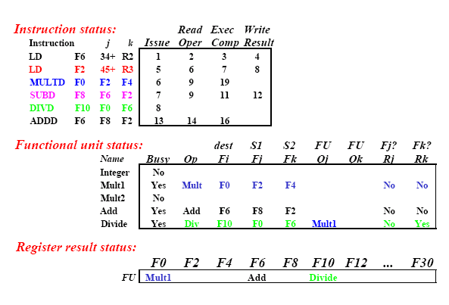
Components of the scoreboard

Slide 101
Example:
Assume the following EX cycle latencies for the floating-
point functional units: Add is 2 clock cycles, multiply is
10 clock cycles, and divide is 40 clock cycles. Consider
the code segment shown below.
L.D F6,34(R2)
L.D F2,45(R3)
MUL.D F0,F2,F4
SUB.D F8,F6,F2
DIV.D F10,F0,F6
ADD.D F6,F8,F2
Show what the status table look like for the execution of
each instruction.

Slide 102
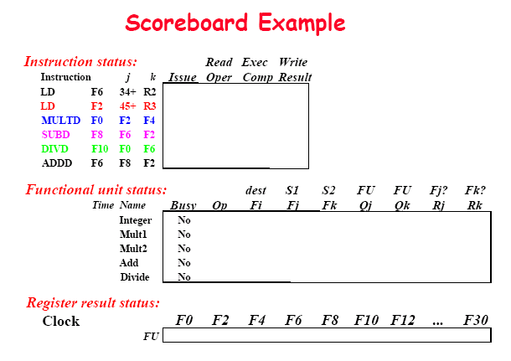

Slide 103
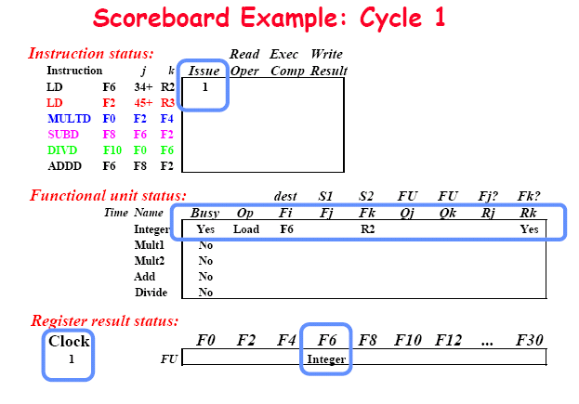

Slide 104
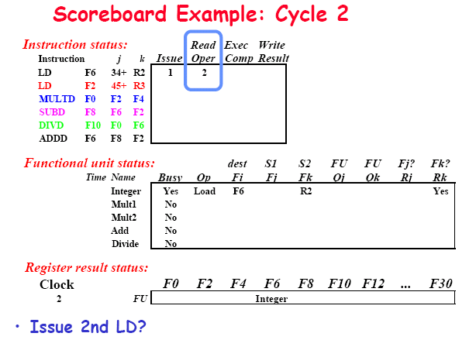

Slide 105
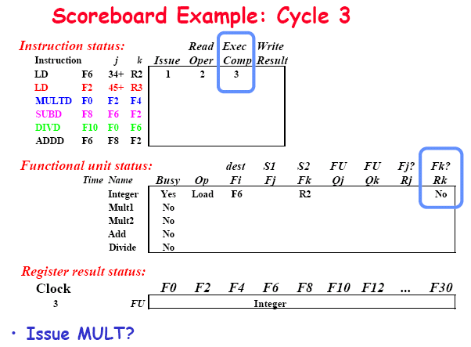

Slide 106
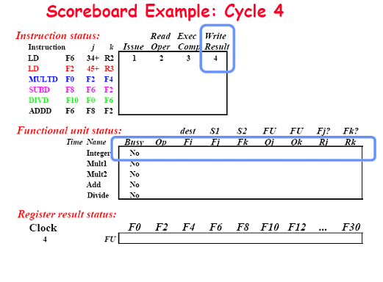

Slide 107
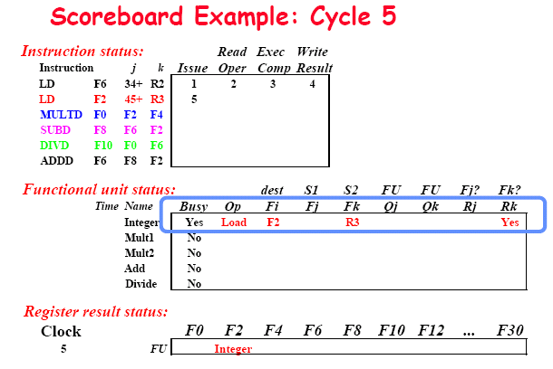

Slide 108
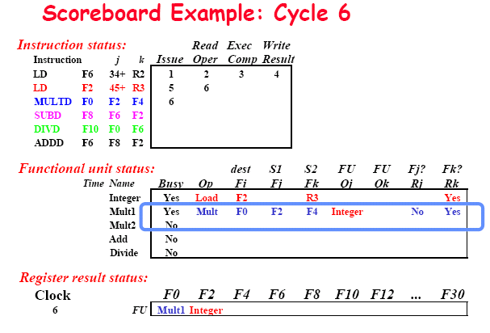

Slide 109
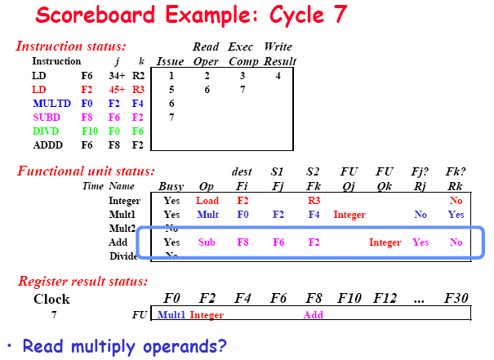

Slide 110
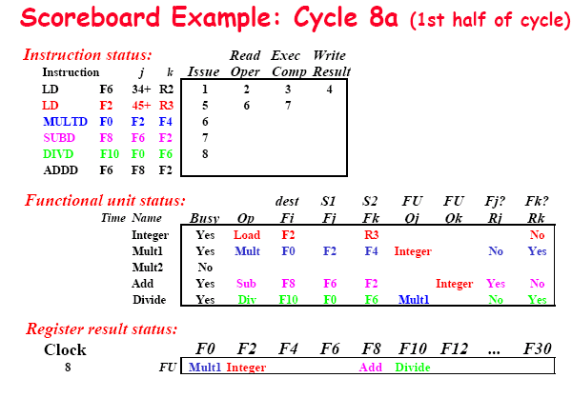

Slide 111
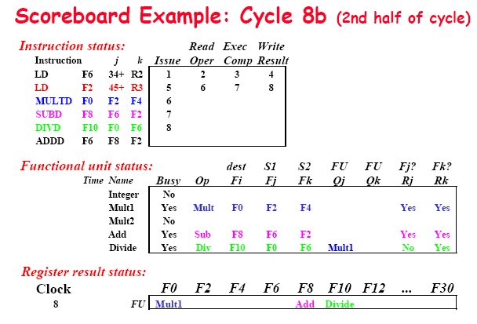

Slide 112
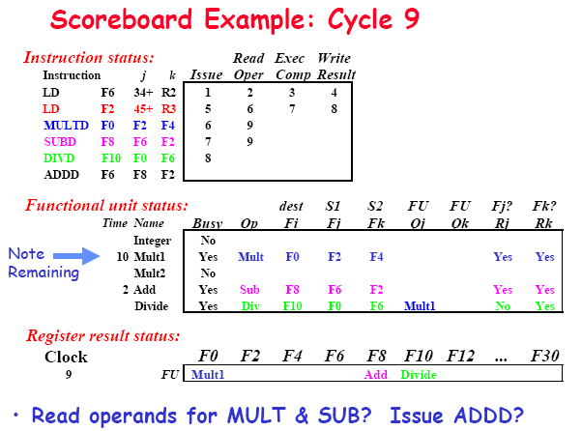

Slide 113
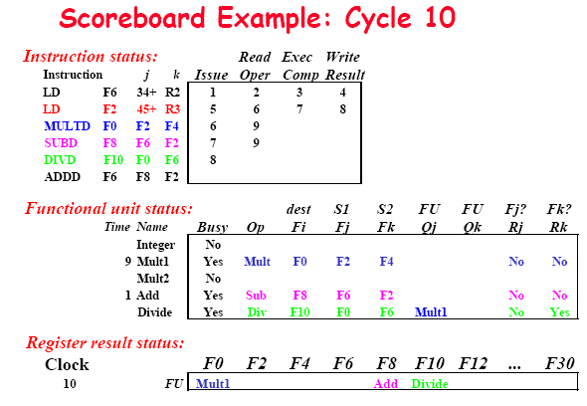

Slide 114
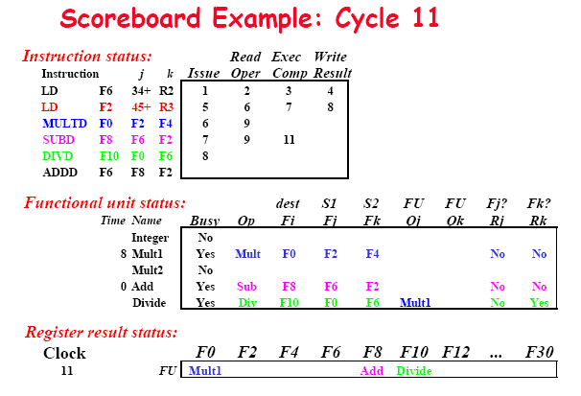

Slide 115
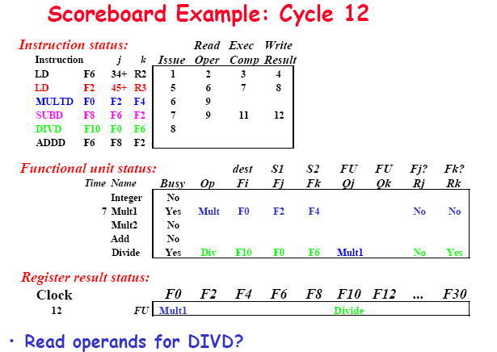

Slide 116
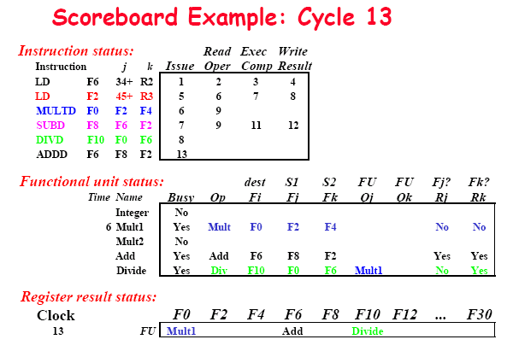

Slide 117
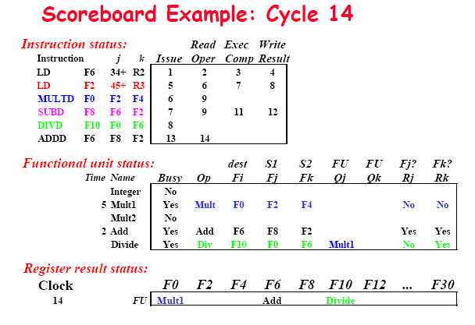

Slide 118
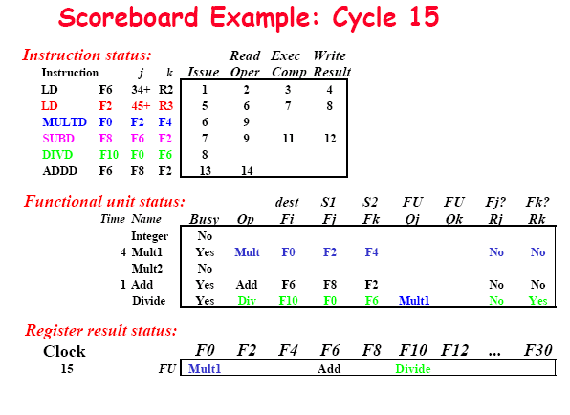

Slide 119
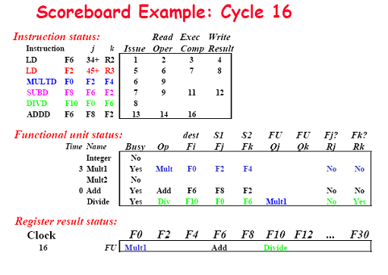

Slide 120
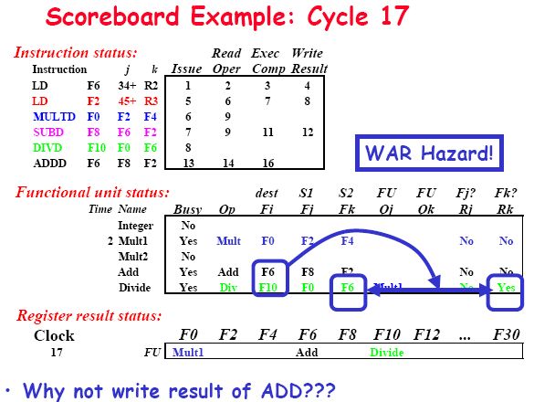

Slide 121
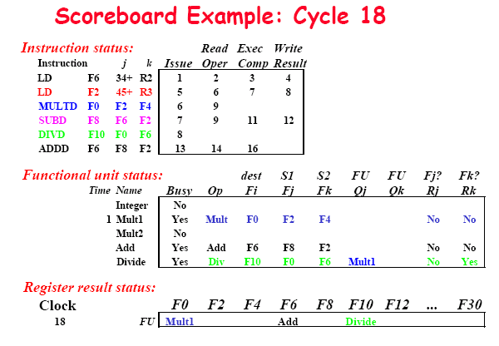

Slide 122
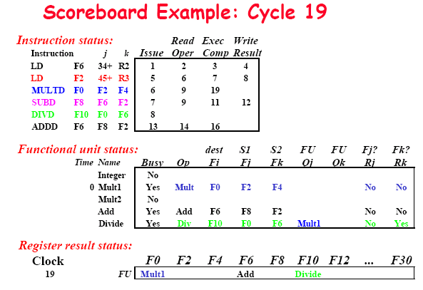

Slide 123
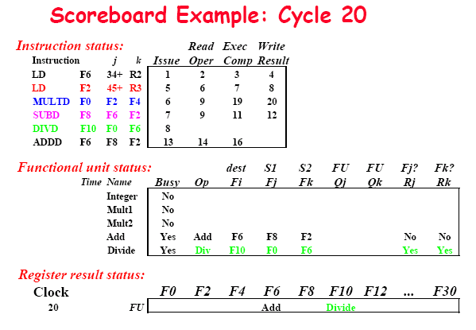

Slide 124
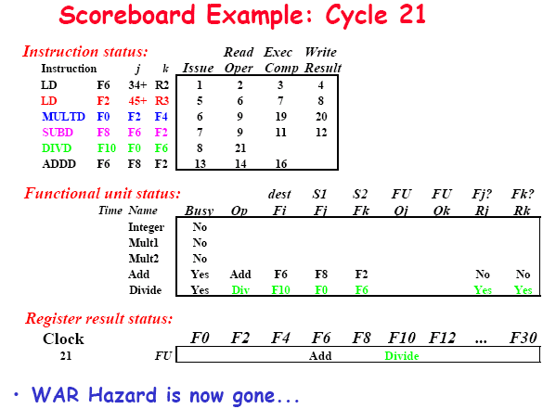

Slide 125
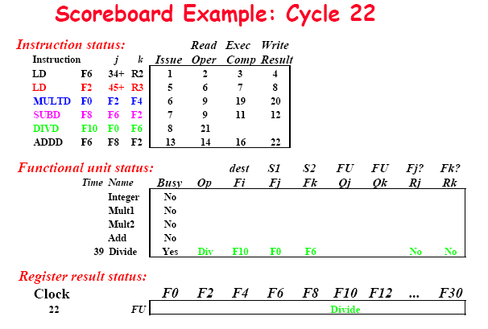

Slide 126
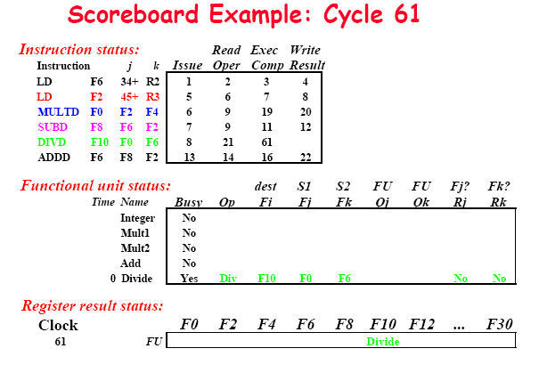

Slide 127
